Slide 1

SecureStego
SECURE DATA HIDING USING
STEGANOGRAPHY AND CRYPTOGRAPHY

Slide 2

SecureStego
A Java-Based Application for Confidential Data Transmission.
Topic
Integrating Cryptography and Steganography for Enhanced Security.
Team Members
Krrish Batra (500119657),
Srijato Das (500119148),
Vineet Kumar (500124147)

Slide 3

Why Steganography is Required in Real Life?
Steganography is essential in modern digital communication because it allows secure, hidden data transmission within files like images, audio, or videos. Unlike encryption, which makes data unreadable without a key, steganography hides the fact that communication is even taking place.
Real-Life Applications of Steganography
1) Secure Communication
2) Digital Watermarking (Copyright Protection)

Slide 4
Problem Statement
In the digital age, ensuring confidential data transmission is crucial. While cryptography protects data through encryption, steganography conceals the existence of the message itself. However, existing solutions lack user-friendliness and are prone to detection.
Objective
Develop a Java-based application that integrates encryption and steganography to securely hide and extract confidential information within media files.

Slide 5
Introduction & System Overview
-The system is a desktop application implemented in Java that:
Encrypts user messages using XOR + Base64 encoding
Embeds encrypted data into:
-PNG images using pixel LSB manipulation
- WAV audio files using LSB manipulation of PCM samples
-GUI implemented using Java Swing
File-based I/O for encryption and media manipulation
Modular design using Object-Oriented Programming principles
TECH STACK
- Language: Java 17+
- Libraries: Swing, javax.imageio, javax.sound.sampled
- Tools: VS Code, Audacity (for WAV processing), Git

Slide 6
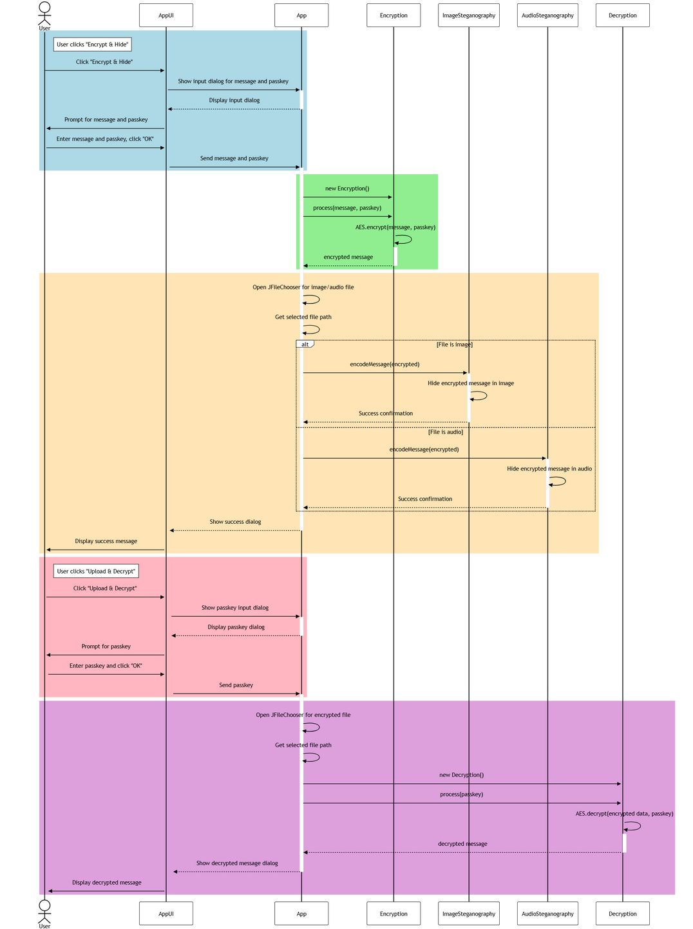
UML & Design Diagrams
- Sequence Diagram
- Class Diagram

Slide 7
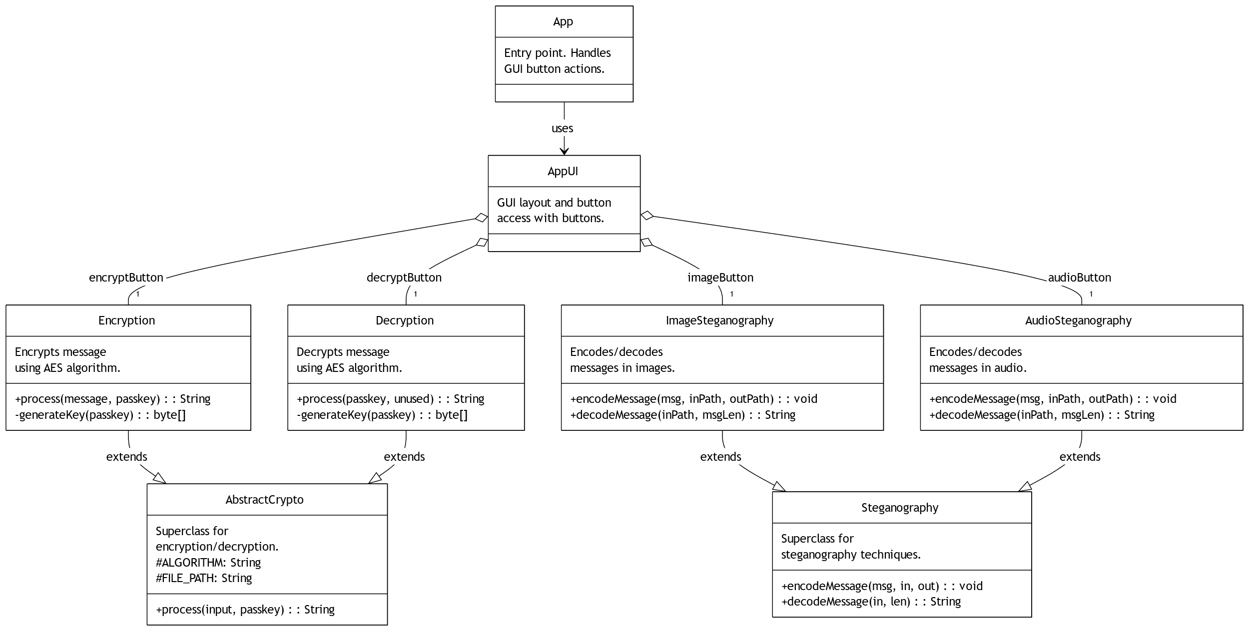

Slide 8
Literature Review / Similar Work/Existing Solutions
OpenStego
Pictograph Stegnography
NoClue-Stegnography
AxCrypt

Slide 9
Gaps Identified:
- No unified, educational implementation combining both cryptography and steganography.
- Lack of modular OOP-based approaches for academic extensibility.
This project fills the gap by:
Integrating encryption and steganography in a modular Java application
Supporting multiple media formats (images, audio)
Using Java core libraries for cross-platform compatibility

Slide 10
Application Flow
A. Encrypt to File
User enters message and passkey → Encrypted using Encryption.process() → Saved to encrypted_message.txt.
B. Decrypt from File
User selects file and enters passkey → File read → Decrypted using Decryption.process() → Message shown.
C. Encrypt & Hide in Image
Message encrypted → User selects image → Hidden using Embedder.embedMessage() → Saved as stego_image.png.
D. Extract & Decrypt from Image
User selects image and enters passkey → Message extracted → If valid Base64, decrypted and shown.

Slide 11
E. Encrypt & Hide in Audio
Message encrypted → User selects .wav file → Hidden using AudioSteganography.embedMessage() → Saved as stego_audio.wav.
F. Extract & Decrypt from Audio
User selects .wav file and enters passkey → Message extracted → If valid Base64, decrypted and shown.

Slide 12
System Architecture
Core Components
- Secure Stego App : Main application driver.
- Encryption Module : AES and RSA encryption via Encryptor interface.
- Steganography Module : Image-based data hiding via Steganographer interface.
- Utility Module : File operations and custom exception handling.

Slide 13
Java Code Demonstration
Encryption.java
- Implements simple XOR encryption with Base64 encoding for secure, reversible transformation.
Embedder.java
- Modifies LSBs of RGB channels in BufferedImage for hiding data.
- Embeds message length (32-bit) + message bytes sequentially.
AudioSteganography.java
- Reads and modifies LSBs of 16-bit PCM WAV audio samples.
- Header-preserving, format-safe writing of stego-audio files.
- Uses ByteArrayInputStream and AudioInputStream for decoding.

Slide 14
OOP Concepts Applied
Abstraction
`AbstractCrypto` used to generalize encryption logic
Encapsulation
Each functional module is isolated
Inheritance
Potential extension to AES/RSA via `AbstractCrypto`
Modularity
UI is decoupled from processing classes.

Slide 15
Outcome
- A secure solution for confidential data transmission.
- Effective use of encryption and steganography.
- Robust system with proper error handling and user authentication.
CONCLUSION

Slide 16
THANK YOU

